Slide 1
Vihaan:
Update on grant implementation
January 2018-January 2019

Slide 2
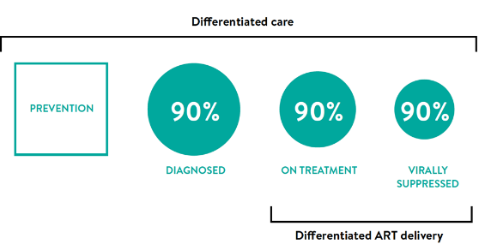
Vihaan Care & Support Programme in 2018 to 2021
The guiding principles:
90:90:90 strategy and targets
Differentiated care
National treatment priorities
Optimum utilization of available resources
Goal: the overall goal of CSC is to improve the survival and quality of life of PLHIV.
Objectives:
  Early linkages of PLHIV to care, support and treatment services
  Improved treatment adherence and education for PLHIV
  Expanded positive prevention activities
  Improved social protection and wellbeing of PLHIV

Slide 3
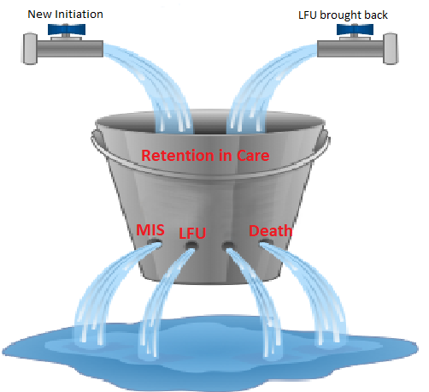
The Lessons learnt & Challenge in retention
4,35,832 LFU clients brought back to the treatment
Moving forward: stopping all leakage

Slide 4

Need for a differentiated care….
One size will not fit for all

Slide 5
Differentiated care and support approach
Category 1
High Priority Clients:
  Clients who are yet to be put on ART
  Clients newly initiated on ART
  clients with less than 80% treatment adherence
  LFU/MIS cases
  Newly TB detected PLHIV cases
  Pregnant Women and children
  Adolescents
  Discordant couples
  PLHIV from Key Populations
Category 2
Stable clients:
Clients with more than 80% adherence
  No adverse drug reactions
  No current opportunistic infection / illness
Categorization
Services
Adherence counselling and consistent follow-up
Accompanied referrals – testing, ART
Outreach Tracking for MIS and LFU
Prevention among discordant couples
Coordination with TI for KPs
Social protection linkages
TB ICF and tracking treatment outcomes
Psychosocial support and counselling
Adherence support groups
Community based dispensation
Social protection linkages
Skills development and livelihood options
TB ICF
Frequency
Newly initiated on ART are consistently followed up for 3 months
MIS/LFU every month
Once a quarter for poor adherence but not LFU/MIS
Every month for TB active cases
Contacted once every six months
Coordination for social protection and entitlements
Adherence Support groups every 6 months

Slide 6

What is differentiated care?
Differentiated care is a client - centered approach that simplifies and adapts HIV services across the cascade to reflect the preferences and expectations of various groups of people living with HIV (PLHIV) while reducing unnecessary burdens on the health system. (http://www.differentiatedcare.org/about)

Slide 7
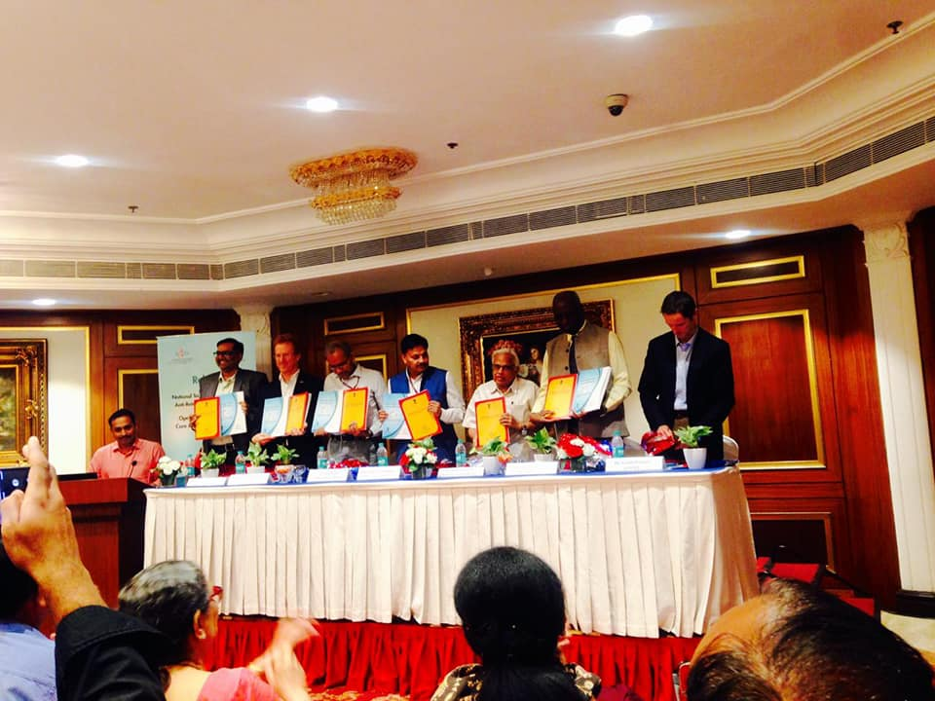
Programme management and implementation Status From Jan 2018 till date..
SR and SSRs establishment: All 12 SR units and 310 fully functional. In addition 10 CSCs supported by other sources
Revised CSC Guidelines: Approved by NACO and officially launched during the NACO CST TRG meeting shared with all SRs and SSRs
Orientation of SR, SSRs, ART centres and SACS on the revised CSC guidelines: All Vihaan SRs, SSR teams, ART centre staffs and SACS officials are oriented on the revised guidelines.

Slide 8
SR unit allocation state level
10 units by SR Partners of which 6 are PLHIV Networks
2 units implemented by Alliance India
NCPI
UPNP
NERO
HLFPPT
NCPI
GSNP
GSNP
LEPRA
NMP
AIRO
TNP AP
KHPT
TNP TN
Lakshadweep
AIRO
Andaman and Nicobar Islands

Slide 9
ART center vs CSC allocation
Jammu & Kashmir (2/1)
Himachal
Pradesh (6/2)
Chandigarh (2/1)
Uttarakhand
(3/2)
Punjab (13/8)
Haryana (1/1
Delhi (11/5)
Sikkim (1/0)
Arunachal Pradesh (1/0)
Rajasthan (24/17)
Uttar Pradesh (38/27)
Assam (6/3)
Nagaland (8/3)
Bihar (21/15)
Meghalaya (2/1)
Manipur
(13/4)
Jharkhand (8/5)
Tripura (3/1)
Gujarat (30/16+7)
Madhya Pradesh (18/11)
West Bengal (19/13)
Mizoram (6/3)
Chhattisgarh (5/3)
Active PLHIV @ ARTC
Maharashtra (73/40+1)
Orissa (15/12)
>1,00,000
Mumbai (17/3)
(ARTC/CSC) : (547/320*)
*310 CSC supported by GF
50000 - 1,00,000
Telangana (22/13)
10,000 – 50,000
<10,000
Goa (2/1)
Andhra Pradesh
(40/23)
Karnataka (64/35)
Pondicherry (1/1)
Tamil Nadu (55/31)
Lakshadweep
Kerala (10/7)
Andaman and Nicobar Islands

Slide 10
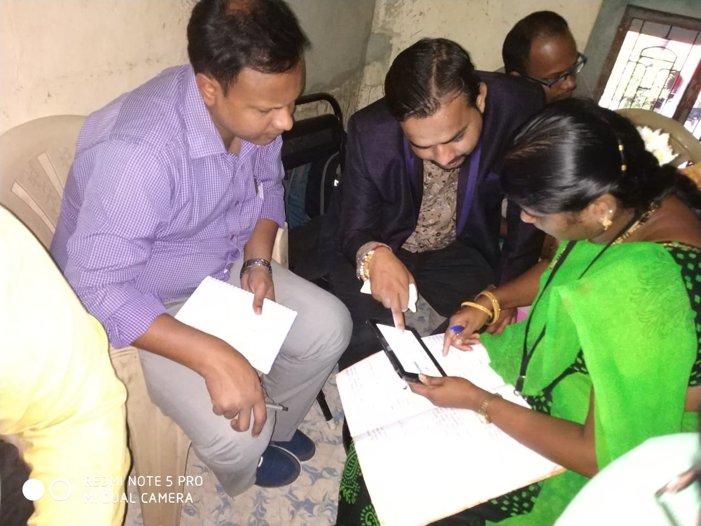
Key activities carried out- January 2018 till date
eMpower tablet customization:
All 12 SRs and 318 SSRs have been oriented on the customised eMpower application
ORW weekly planner as per differentiated care developed
Automation of MPR initiated
Review meetings: 2 regional level meetings and 1 national review meeting have been jointly conducted by Alliance India and NACO
Mission Sampark Drive:
Completed the drive and the final report launched officially during the National CST review meeting held on 15th – 17th Jan 2019
Tracking outcome report approved by Union Health Minister
NACO has revised ART MPR to report the untraceable number
Improved national treatment data leading to scale up of ART initiation and LFU track back to ART.

Slide 11
Differentiated care & support services (Jan ’18 – Jan ‘19)
N=1,387,405

Slide 12
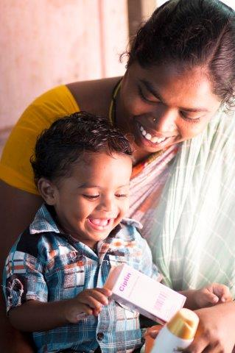
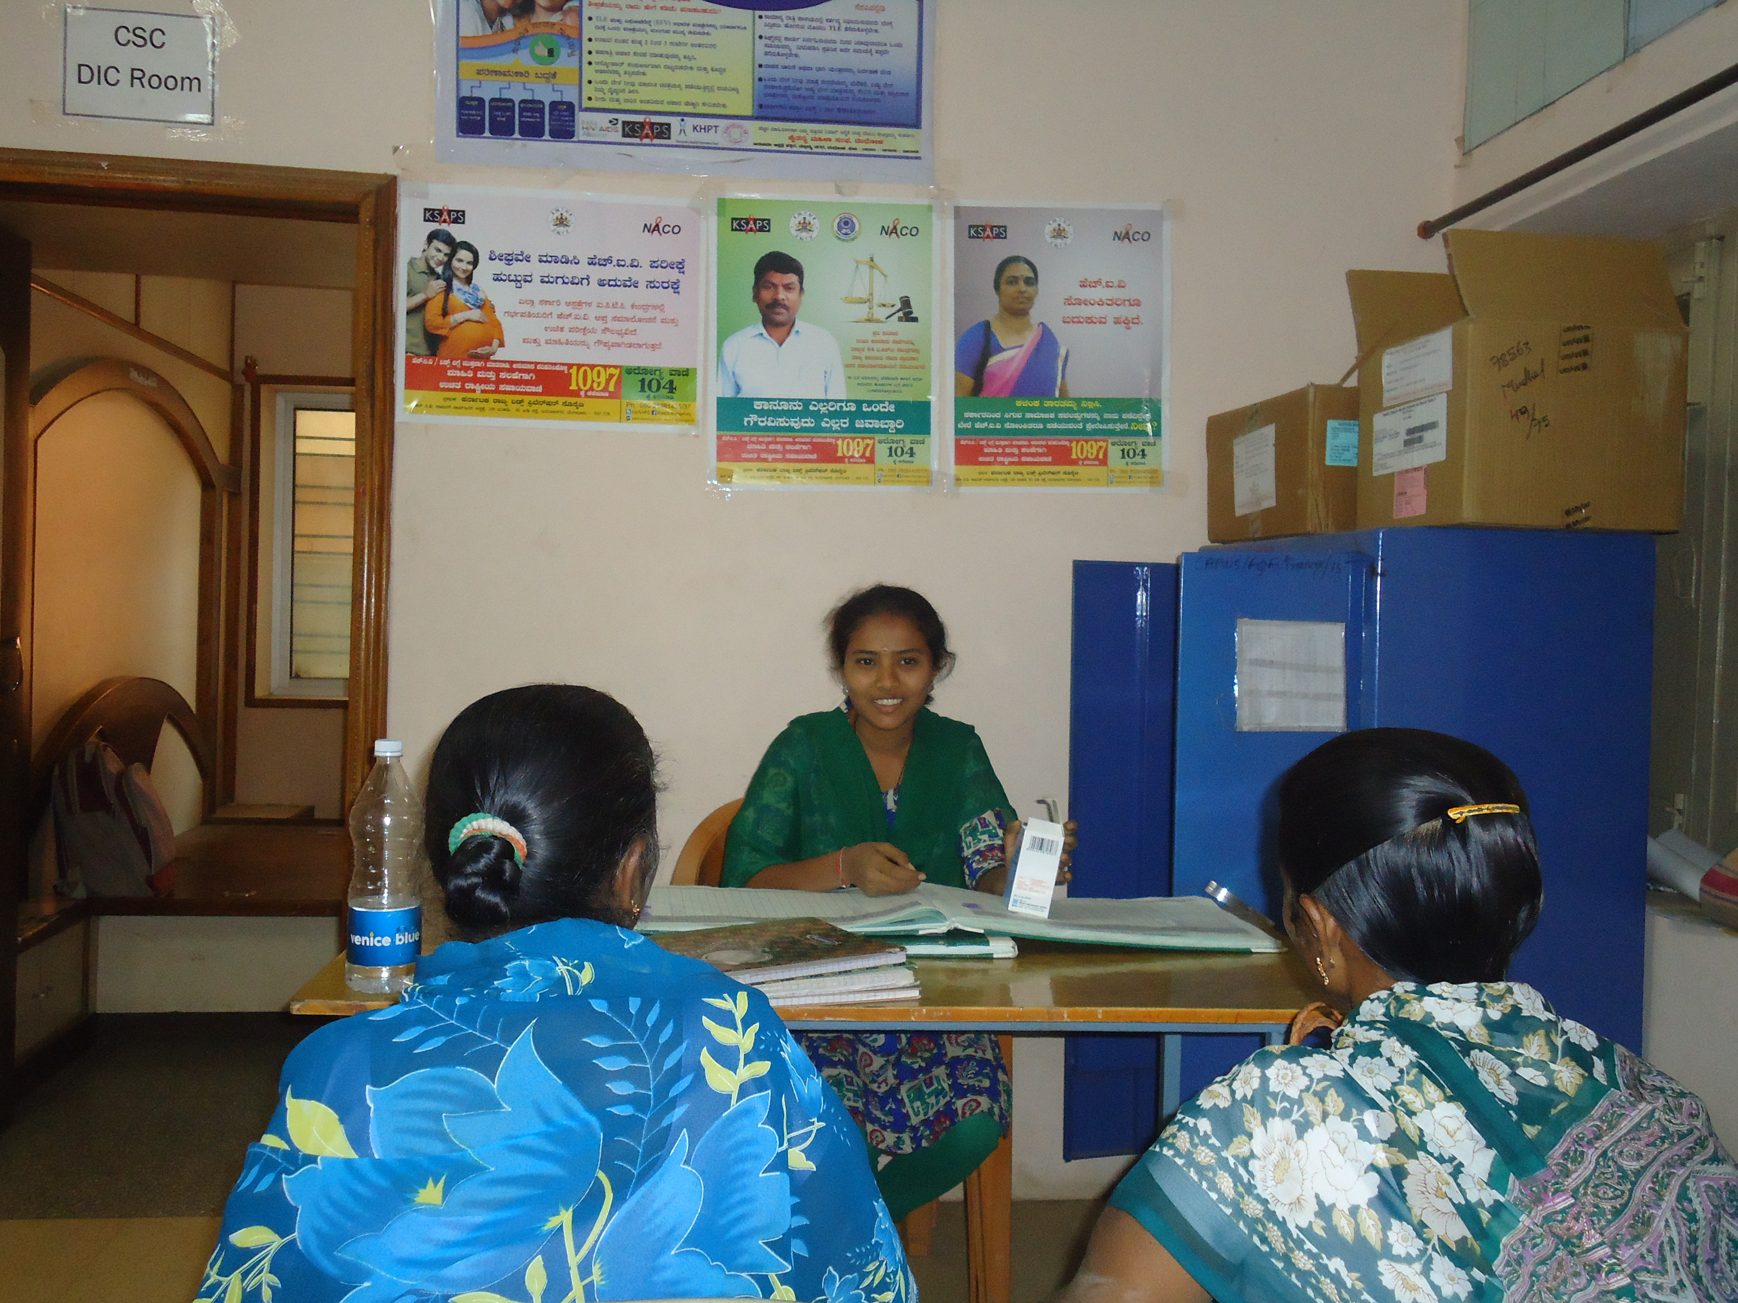
Community Based Dispensation of ART
The CSCs dispense ART to PLHIV
Stable Clients
Flexible Hours and Timing
Faster and Efficient
From the peers and re-enforces the adherence message
17 CSCs (15 CSCs in Karnataka, 1 CSC in Gujarat and 1 in Mizoram) have started community based dispensing facility reaching out to 1250 stable clients

Slide 13
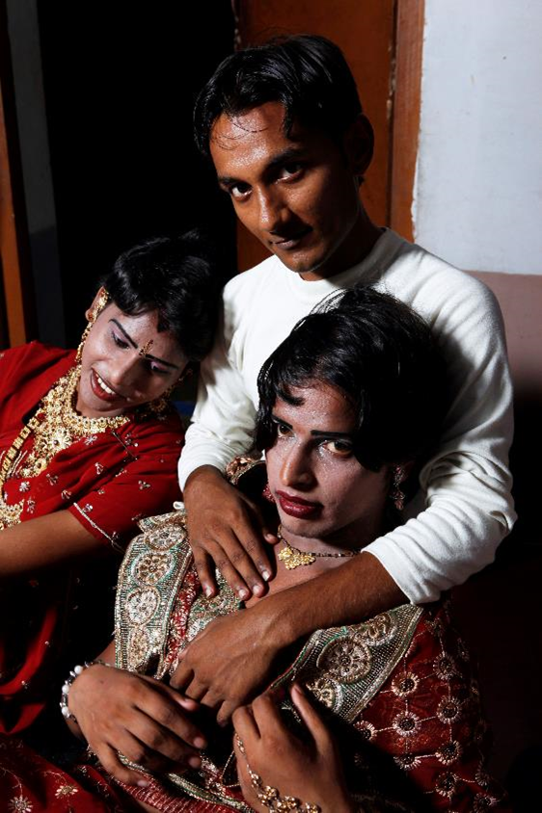
Care and Support Centre (CSC)for Transgender
Transgender Populations and HIV:
  HIV prevalence among the general population is estimated to be 0.26% whereas among transgender stands at 7.5%
  6792 TG are registered in ART programme across India as of May 2018. But, of them, only 3506 are in active care which is 51.6% of total registration
Why TG-specific CSC?:
  Gap in the coverage: 80% of the cases tested positive reach ART, of them 50% are currently in active care
  Lack of TG specific services in the general CSCs
  Poor Treatment literacy and adherence
  Difficulties in reaching out to their sexual partners for HIV testing
  Limited linkages with social schemes and entitlements
Selected Sites: Delhi, Bangalore, Kolkata, Chennai, Thane, Mumbai, Baroda, Bhuvaneshwar, Chittoor, Warrangal
Current reach: 601 (as on Dec 2018)

Slide 14
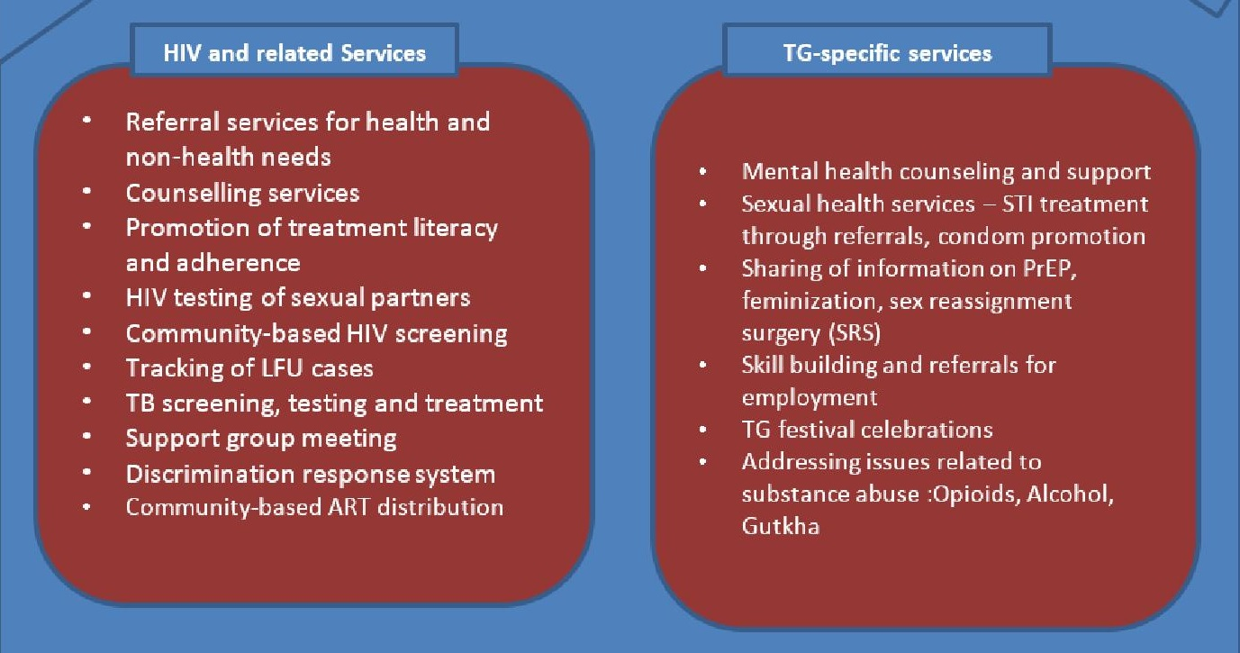
Service package of TG-CSC

Slide 15
Performance Framework (Jan ‘18 to Jan ‘19)
Indicator # | Coverage Indicator | Target | Achievement (Jan 2019) | %
TCS-Other 1: | Proportion of PLHIV on ART received differentiated care & support services to retain them in treatment | 1,273,323 | 1,022,656 (New clients:64,263; <80% adher.:80,340; Stable clients: 878,053) | 80.3%
TB/HIV-3.1: | Percentage of people living with HIV in care (including PMTCT) who are screened for TB in HIV care or treatment settings | 1,022,656 | 653,259 | 63.9%
HTS-1: | Number of people who were tested for HIV and received their results during the reporting period | 96,678 | 31,791 | 32.9%
TCS-Other 2: | Percentage of PLHIV who are lost to follow up (LFU) and missed to ART center tracked back with definite outcome | 591,799 (267,145+ 324,654) | 324,654 (On-ART LFU: 137,447; On-ART MIS: 187,207) | 54.9%

Slide 16
Reason for not able to test family members for HIV
In 7 selected states (as per random selection) for 15 days and 6,554 respondents were contacted to motivate for family members HIV testing. (October 2018)
Findings:
61% of the respondents have less awareness and health seeking behavior or disclosure issue
  Feel better now and do not need test (32%)
  Not having sexual relationship with spouse/partners (13%) and
  Always use condom (11%).
  5% of the respondents didn’t disclose their HIV status with their spouse/partner which is more risky of spreading HIV with partners.
19% of the respondents not tested due to their working timings, school timings (for children), long distance and no travel money.
12% has other reasons where they gave verbal conformation of their family member being tested and found negative but no proofs were available,
8% of the respondents’ spouses/partners/children are residing in different place and so not able to take them for testing.

Slide 17
Few Additional initiatives as part of differentiated services for different profiles of PLHIV

Slide 18
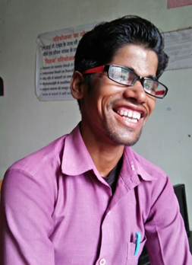
Skill building initiative – Oracle and HSBC
Prime objective: To provide skill training and job placement to youth living with and affected by HIV mobilized from the Vihaan-Care & Support Centers
Current Progress:
  Total mobilized: 2374
  Total enrolled: 876
  Candidates completed training: 467 (more expected by Jan 2019)
  Candidates placed training: 173

Slide 19

Ready+ Training for Youths
Increases awareness of sexual reproductive health among PLHIV between 18 to 25 yrs. In 5 States-Manipur, UP, Rajasthan and Maharashtra and Delhi
Identify the peer champions from adolescents and young PLHIV community and capacitate them
Around 200 youths were trained and 25 peer champions were selected
Post training activities:
  continued to disseminate information to their peer networks (5 WhatsApp groups)
  Referral to ART, treatment adherence counseling
  Engaged with youth programme under state programme

Slide 20
Budget Vs. Expenditure Analysis
Description | Jan-Sep-18 | Oct-Dec-18 | Total (Jan-Dec-18)
 | (in INR) | (in INR) | (in INR)
Approved Budget | 3485,52,147 | 1111,47,007 | 4596,99,154
Actual Expenditure | 448,13,111 | 235,22,088 | 683,35,200
Onward Grants/ Disbursement | 2725,79,426 | 853,37,117 | 3579,16,543
% Utilisation/Burn Rate | 91% | 98% | 93%

Slide 21
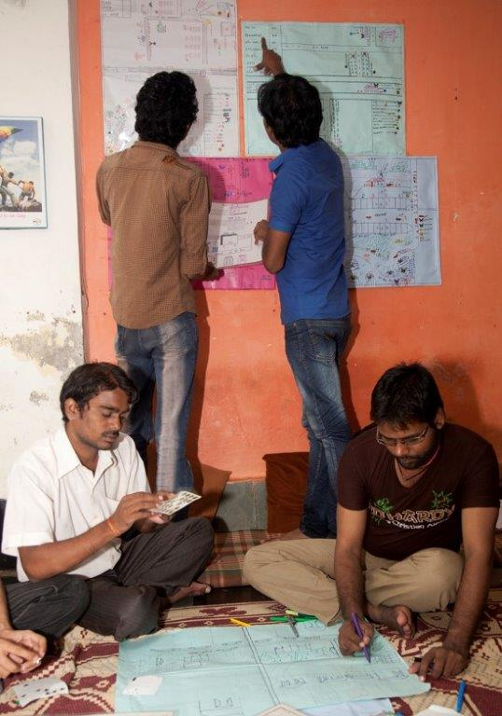
Programme : Limitations & challenges
Covering entire PLHIV and affected partners/families scattered across the states
Increase in mandate and expectations from States
High staff turn over, no training provision to orient the new staff.
Reduction of CSCs and consequently ORWs starting from 2020 Jan onwards will make the situation more challenging.

Slide 22
