Slide 1
The Global Fund Grant Jan 2018 to Mar 2021
Joint Effort for Elimination of Tuberculosis
( JEET PROJECT )

Slide 2
Joint Effort for Elimination of Tuberculosis
Aim:
Intensive engagement with the private sector to achieve universal access to quality diagnosis and treatment for TB and help the nation in achieving it’s NSP targets of TB elimination (28 / 4.8 / 18)
Objective:
1. Develop an insight into private sector by conducting mapping & prioritization of private sector healthcare providers
2. Facilitate nationwide access to RNTCP approved affordable TB diagnostics for patients seeking care in the private sector through public and private lab network for increased notifications and quality diagnosis
3. Facilitate nationwide access to early, appropriate and free treatment initiation, public health actions and adherence support systems for patients seeking care in the private sector

Slide 3
Key Activities:
Mapping and Prioritization of private sector providers
Ensuring nationwide access to WHO approved quality TB diagnostics to patients seeking care in the private sector
Enabling early, appropriate and free treatment initiation, public health actions and adherence support systems
Expected Impact:
1.6 million notifications over 3 years
To report successful treatment outcomes of 70%
Setup effective and sustainable PPM strategy pan India
CHRI, WJCF and FIND will work together under Project ‘JEET’ to implement the project nationally during the grant period 2018-2021

Slide 4
JEET Partners
3 Partner organizations will engage with 15000+ doctors in more than 400 cities in 23 states
William J Clinton Foundation (WJCF)
Centre for Health , Research and innovation (CHRI)
 | WJCF
 | CHRI
 | FIND
Foundation for Innovative New Diagnostics (FIND)

Slide 5
JEET Secretariat
Composition
Representatives from CTD, WHO and consortium partner organizations
Responsibilities of JEET Secretariat
Responsibilities of JEET secretariat
Providing strategic guidance to the JEET team in achieving project objectives
Maintaining effective collaboration with stake holders and jointly representing JEET to Ministry of Health and Family Welfare, World Health Organization, CCM or other stakeholders
Periodically reviewing project progress and proactively identifying challenges. Guide teams to course correct
Facilitating cross learning and collaboration between JEET partners

Slide 6
PROJECT TITLE: Joint Effort for Elimination of Tuberculosis (JEET) for patients seeking care in private sector
 | CHRI | FIND | WJCF
Geographical coverage | 10 States | 6 States | 7 States
 | 176 Districts | 94 Districts | 175 Districts
Grant Amount | US$ 15.59 million | US$ 8.06million (US$ 33.14 million -Total) | US$ 14.3 million
HR Count | 891 | 565 | 849
Sub Recipients | Maharashtra Jan Vikas Kendra | Karnataka Health Promotion Trust | World Health Partners
 | TB Alert India | TB Alert India | TB Alert India
 | Lepra | World Health Partners | Lepra
 | World Vision India |  | World Vision India
 | MAMTA

Slide 7
CHRI will implement PPSA model in 29 districts and PPSA lite model in 171 districts cities across 10 states
PPSA lite: 1 district in J &K
PPSA: Guwahati
PPSA lite: 11 districts in Assam
SR: World Vision
Jammu & Kashmir
PPSA lite: 3 districts in Uttarakhand
Uttarakhand
PPSA: 15 cities
PPSA lite: 45 districts in UP
SR: LEPRA and MAMTA
Uttar Pradesh
Assam
Jharkhand
PPSA: 13 cities
PPSA lite: 37 districts in Maharashtra
SR: Maharashtra Janavikas Kendra and Alert India
Chhattisgarh
PPSA lite: 8 districts in Jharkhand
Odisha
Maharashtra
PPSA lite: 1 district in Goa
PPSA lite: 18 districts in Chhattisgarh
Goa
PPSA lite: 14 districts in Kerala
PPSA lite: 10 districts in Odisha
Kerala
7

Slide 8
FIND will implement PPSA model in 21 districts and PPSA lite model in 73 districts cities across 6 states
PPSA lite: 4 districts in Himachal Pradesh
Himachal Pradesh
PPSA: 2 cities
PPSA lite: 7 districts in Punjab
Punjab
PPSA: 2 cities
PPSA lite: 16 districts in Telangana
West Bengal
PPSA: 1 city
PPSA lite: 17 districts in West Bengal
Telangana
PPSA: 1 city
PPSA lite: 12 districts in Andhra Pradesh
PPSA: 1 city
PPSA lite: 16 district in Karnataka
Andhra Pradesh
Karnataka
8

Slide 9
WJCF will implement PPSA model in 34 districts and PPSA lite model in 141 districts cities across 7 states
PPSA: Gurgaon
PPSA lite: 15 districts in Haryana
SR: TB Alert India
PPSA: Darbhanga
PPSA lite: 27 districts in Bihar
SR: World Health Partners
PPSA: Delhi
SR: TB Alert India
Haryana
Delhi
PPSA: Jaipur
PPSA lite: 22 districts in Rajasthan
SR: World Vision India
Rajasthan
Bihar
Gujarat
Madhya Pradesh
PPSA: Ahmedabad, Surat
PPSA lite: 30 districts in Gujarat
SR: World Health Partners
PPSA: Bhopal, Indore
PPSA lite: 26 districts in Madhya Pradesh
SR: Lepra India
PPSA: Chennai
PPSA lite: 21 districts in Tamil Nadu
SR: World Vision India
Tamil Nadu
9

Slide 10
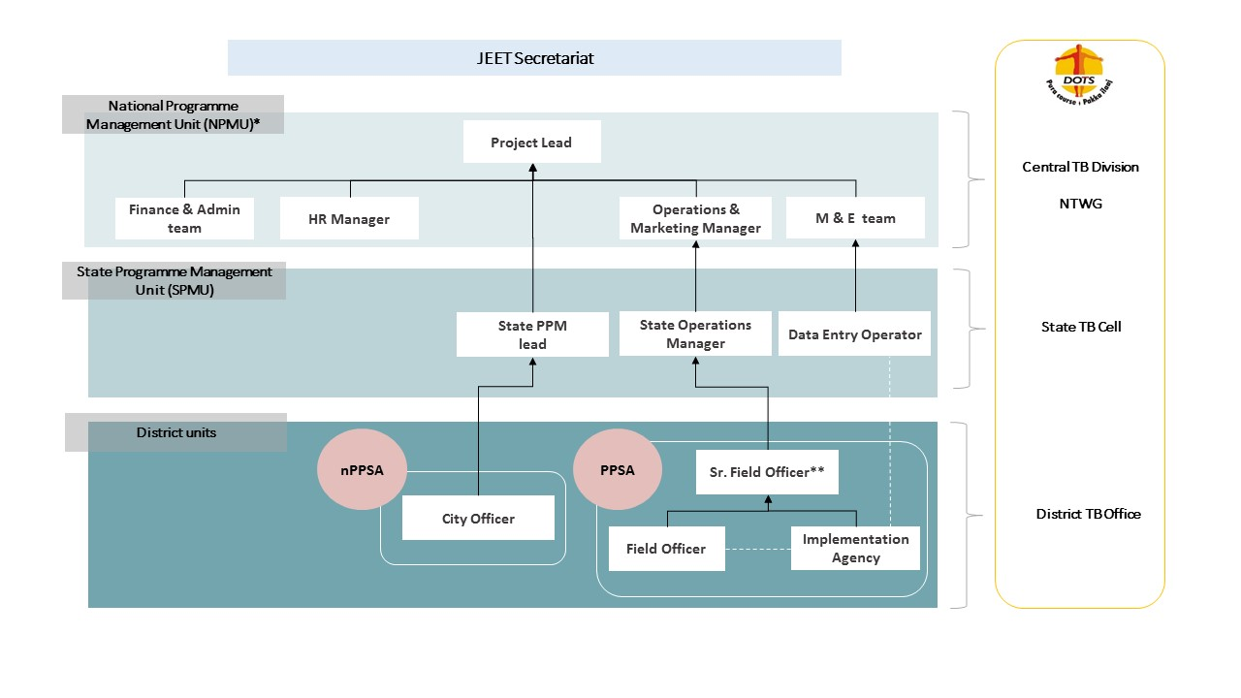

Slide 11
Implementing Models
PPSA Model
- Human Resource Intensive
-Provider engagement & Patient services
Implementation done through IA
- IA reports on notifications and treatment outcomes with support of FOs
-
PPSA lite Model
Limited Resources
Provider engagement % Capacity building of RNTCP staff
- Direct involvement of District RNTCP staff for implrentation
- Reports on notifications and treatment sucees with support of RNTCP

Slide 12
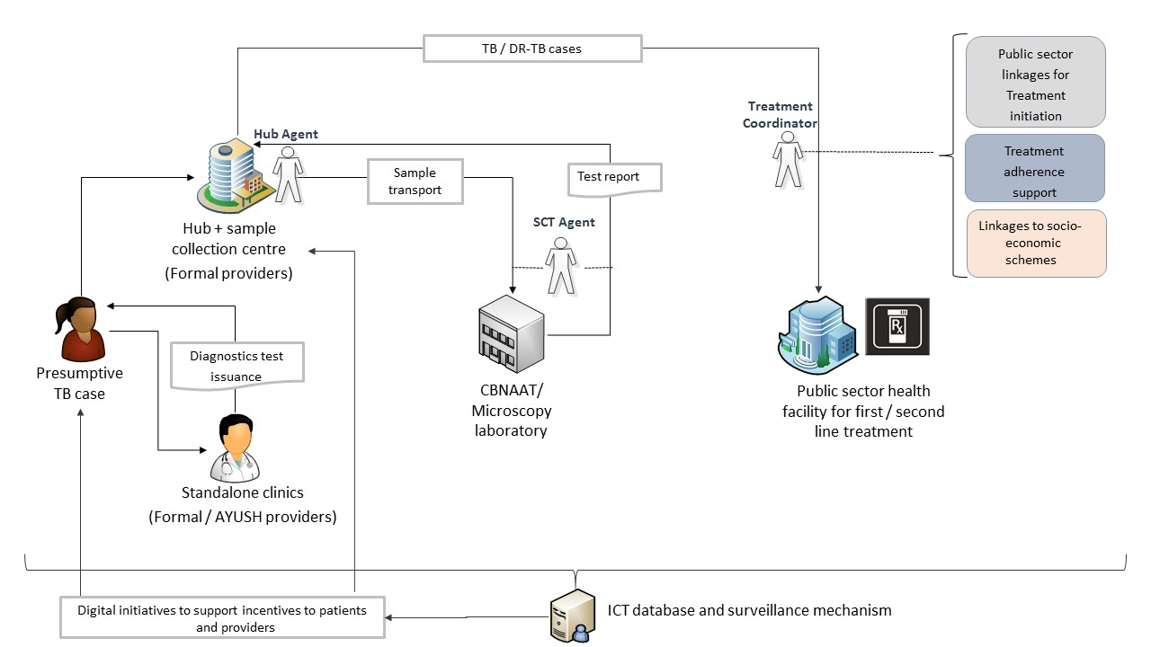
Service Delivery Model - PPSA

Slide 13
Implementation Structure (PPSA lite)

Slide 14
Implementation Status (Programmatic) 01st January to 30th September 2018
Indicator | CHRI |  | FIND |  | WJCF
Number of notified TB cases (all forms) contributed by non-national TB program providers – private/non-governmental facilities | Target | Achieved | Target | Achieved | Target | Achieved
 | 30,055 | 32,217 | 10,858 | 14,925 | 24,485 | 28,888
Treatment success rate (all forms): Percentage of TB cases (all forms), bacteriologically confirmed plus clinically diagnosed, successfully treated (cured plus treatment completed) among all TB cases registered for treatment during a specified period (new and relapse cases) | NA |  | NA |  | NA

Slide 15
Implementation Status (Programmatic) 01st October to 31st December’18
Indicator | CHRI |  | FIND |  | WJCF
Number of notified TB cases (all forms) contributed by non-national TB program providers – private/non-governmental facilities | Target | Achieved | Target | Achieved | Target | Achieved
 | 34,467 | 28,981 | 11,740 | 9,527 | 26,662 | 26,411
Treatment success rate (all forms): Percentage of TB cases (all forms), bacteriologically confirmed plus clinically diagnosed, successfully treated (cured plus treatment completed) among all TB cases registered for treatment during a specified period (new and relapse cases) | NA |  | NA |  | NA

Slide 16
Financial Performance (January to December 2018)
PR | Allocated Budget (in INR) | Actual Expenditure. (In INR) | Proportion of Expenditure (in %)
CHRI | 3240.03 | 1247.06 | 38%
FIND | 43,07,79,198 | 26,47,05,908 | 61%
WJCF | 27,42,44,239 | 9,11,75,290 | 33%

Slide 17
Challenges and mitigation plan
Challenges
Mitigation Strategy
Support requested from RNTCP
Timely forecasts of commodities and remedial measures.
Manpower and working hours optimization to reduce TAT
Leverage alternate resources (LT schemes/ PPM DST schemes/ IPAQT labs)
Rolling out universal DST
Dependency on NTP for commodities:
Free CB-NAAT testing for eligible presumptive TB patients & timely reporting
Free FDC for private sector patients
Timely incentive disbursals to beneficiaries

Slide 18
Way Forward Including the activities for 2019 – Q1 & Q2
Focus on n-PPSA CMEs
RNTCP staff meetings/ trainings
Strengthening patient treatment adherence systems
Facilitating/ Advocacy for provider incentives

Slide 19
Thank You!

Slide 20
FINANCIAL Update: WJCF Jan to Dec 2018
(Amounts in lakhs INR)
Major Activities | Budget Q1 – Q4 (INR) | Expenditure Q1-Q4 (INR) | Savings | Reason for Variance
Human Resource | 1171.2 | 473 | 698.2 | Underspending under the head is due to delay in recruitment of staff at PR and SR level.
Travel related cost | 1092.3 | 86.4 | 1005.9 | Delays in recruitment resulted in lesser staff travel than budgeted. National level review with CTD postponed to Q1’19
Non Health equipment | 133.6 | 53.8 | 79.8 | MIS Development delayed due to contract review by GF
Communication material and publications | 75.1 | 19.4 | 55.7 | Delay in project implementation
Program Administrative cost | 126.8 | 64.9 | 61.9 | Delay in implementation in ground and delay in selection of SR and establishment of SR office.
Living support to client/ target population (LSCTP) | 56.5 | 6.6 | 49.9 | This expenditure is incurred only in case of non supply of material by DTC/STC, hence minor expenditure incurred under the head.
Total | 2655.6 | 704.1 | 1951.5

Slide 21
Jan - Dec 18: Budget Vs Expenditure – FIND India and Major Reasons for Underspend
Human Resource (HR):
Delayed onboarding of Sub-grant recipients of JEET grant has impacted the expenditure on account of phased recruitments of field staff. The recruitments are being expedited.
Travel Related Cost (TRC):
This is on account of delayed recruitment which in in turn has impacted the expenditures pertaining to travel related costs (travels, meetings, trainings, CMEs etc.). Proportion of the said un-executed activities have been rationally carried forward & we expect that the same would be executed in subsequent quarters.
External Professional services (EPS):
Most of the costs pertain to Lab Information Management System (LIMS) & is part of our current commitments which will be booked in subsequent quarters.
Budget in INR | Budget in USD | Expenditure in INR | Expenditure in USD | Proportion of Expenditure(%) | Variance in INR | Variance in USD | Proportion of variance (%)
43,07,79,198 | 66,27,372 | 26,47,05,908 | 39,47,624 | 61% | 16,60,73,291 | 26,79,749 | 39%

Slide 22
FINANCIAL ACHIEVEMENTS - CHRI
Jan. 2018 to Dec. 2018
(Amounts in lakhs INR)
Major Activities | Budget Q1 – Q4 | Expenditure Q1-Q4 | Savings | Reason for Variance
Human Resource | 1,157.57 | 716.64 | 440.94 | Underspending under the head is due to delay in recruitment of staff at PR and SR level.
Travel related cost | 440.35 | 111.13 | 329.22 | Underspent under TRC is due to delay in recruitment of staff less expenditure incurred on travel/training/meetings
External Professional Services | 1,356.08 | 290.10 | 1065.98 | Less expenditure due to delay in finalisation and signing of agreement with IMS for PP mapping. Agreement with IMS was signed in 1st week of November 2018
Non Health equipment | 78.16 | 47.06 | 31.10 | Less expenditure charged based on actual
Program Administrative cost | 144.65 | 72.82 | 71.83 | PR level, less P&A due to delay in implementation in ground and delay in selection of SR and establishment of SR office.
Living support to client/ target population (LSCTP) | 63.22 | 9.32 | 53.90 | This expenditure is incurred only in case of non supply of material by DTC/STC, hence minor expenditure incurred under the head.
Total | 3240.03 | 1247.06 (38%) | 1992.98
Continued to next

